Slide 1

UNIT 1-2
EE 471 POWER SYSTEM ANALYSIS I
Prof. Dr. Sezai Dinçer

Slide 2

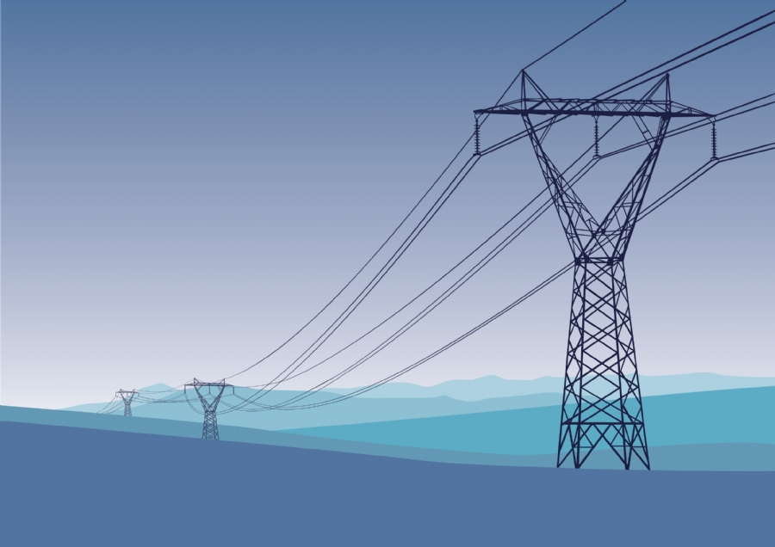
EE 471 POWER SYSTEM ANALYSİS I

Slide 3
REFERENCES
Power System Analysis: John J. Grainger and William D. Stevenson, J. R.
McGraw-Hill, 1994 ISBN: 0-07-061293-5
2. Power System Analysis and Design : JD Glover ,MS Sarma ,
TJ Overbye Cengage Learning, 2012 ISBN-13-978-1-111-42579-1
50% MT ,50% FINAL

Slide 4
EE 472
Prepared by : Prof. Dr. M. Sezai DİNÇER
COURSE PLAN
week | Topics
1 2 | INTRODUCTION Installed Capacity and Consumption per capita
3 | INDUCTANCE of Transmission Lines , Inductance of a Conductor Due to Internel Flux , Flux linkages between two Points External to an Isolated conductor.
4 | Inductance of a Single-Phase Two-Wire Line .Flux Linkages of One Conductor in a Group. Geometric Mean Distance
5 | Examples of Inductance Computations , Inductance of Three-Phase Lines with Equilateral Spacing. Inductance of Three-phase Lines with Unsymmetrical Spacing. Transposition of transmission Lines
6 | CAPACITANCE of transmission Lines. The Potential Difference between Two Points Due to a Charge. Capacitance of a Two-wire Line. Potential Difference between Two Conductors of a Group of Charged Conductors
7 | Capacitance of a Three-phase Line with Equilateral Spacing Capacitance of a Three-phase Line with Unsymmetrical Spacing
8 | CURRENT AND VOLTAGE RELATIONS ON A TRANSMISSION LINE.
9 | The Short Transmission Line The Medium-length Line
10 | MIDTERM
11 | REPRESENTATION OF POWER SYSTEMS
12 | One Line Diagram , Per-Unit Systems
13 | Power System Modelling
14 | Symmetrical Faults
15 | FINAL

Slide 5
Consumption Per Capita

Slide 6
Consumption Per Capita

Slide 7
Electricity Production

Slide 8
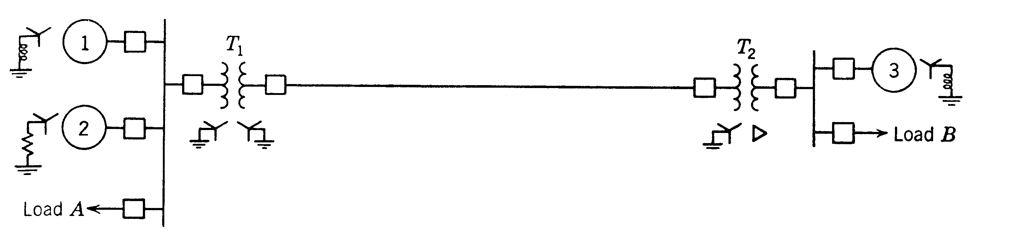
ONE LINE DIAGRAM
Sample Power System

Slide 9
ONE LINE DIAGRAM
Since a balanced three-phase system is always solved as a single-phase circuit composed of one of the three lines and a neutral return, it is seldom necessary to show more than one phase and the neutral return when drawing a diagram of the circuit. Often the diagram is simplified further by omitting the completed circuit through the neutral and by indicating the component parts by standard symbols rather than by their equivalent circuits. Such a simplified diagram of an electric system is called a one-line diagram. It indicates by a single line and standard symbols the transmission lines and associated apparatus of an electric system.

Slide 10
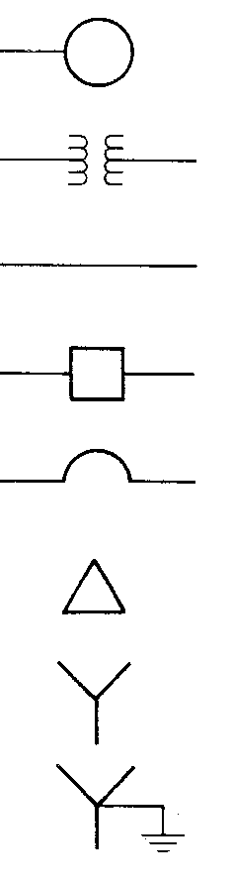
Generator, Rotating Machine
Transformer
Transmission line
Breaker
Air Circuit Breaker
Delta Connection
Star Connection
Star Connection Neutral
Grounded

Slide 11
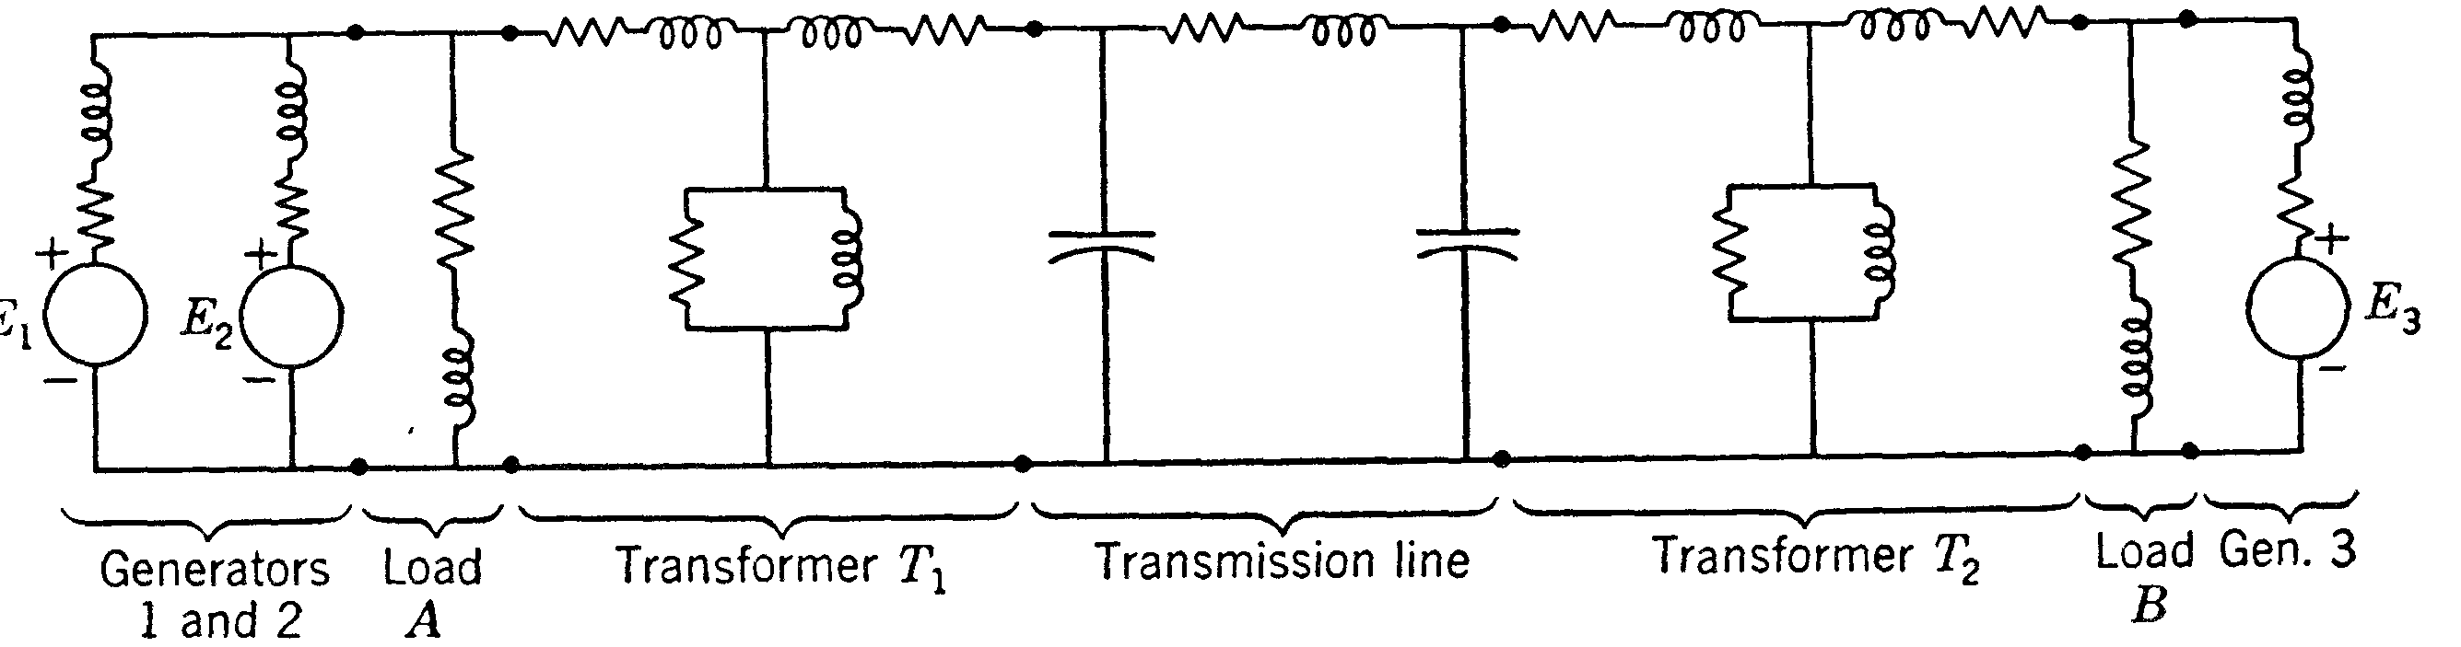
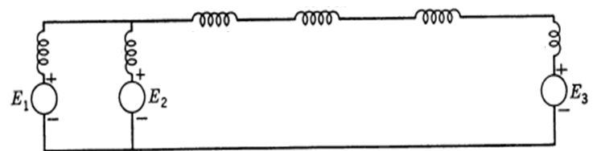
Sample System Impedance and Reactance Diagrams

Slide 12
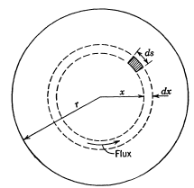






LINE PARAMETERS :Inductance of Transmission Lines
Inductance of a Conductor Due to Internel Flux
The magnetomotive force (mmf) in ampere-turns around any closed path is equal to the current in amperes enclosed by the path. The mmf is also equal to the integral of the tangential component of the magnetic field intensity around the path
where I is the total current in the conductor.
Amperes Law
where µ is the permeability of the conductor
SOLID ROUND
CONDUCTOR

Slide 13


Inductance due to Internal Flux
In the tubular element of thickness dx, the flux dψ is B_{x} times the cross-sectional area of the element normal to the flux lines, the area being dx times the axial length. The flux per meter of length is
The flux linkages dψ per meter of length, which are caused by the flux in the tubular element, are the product of the flux per meter of length and the fraction of the current linked. Thus
Integrating from the center of the conductor to its outside edge to find , the total flux linkages inside the conductor

Slide 14





Inductance due to Internal Flux

Slide 15
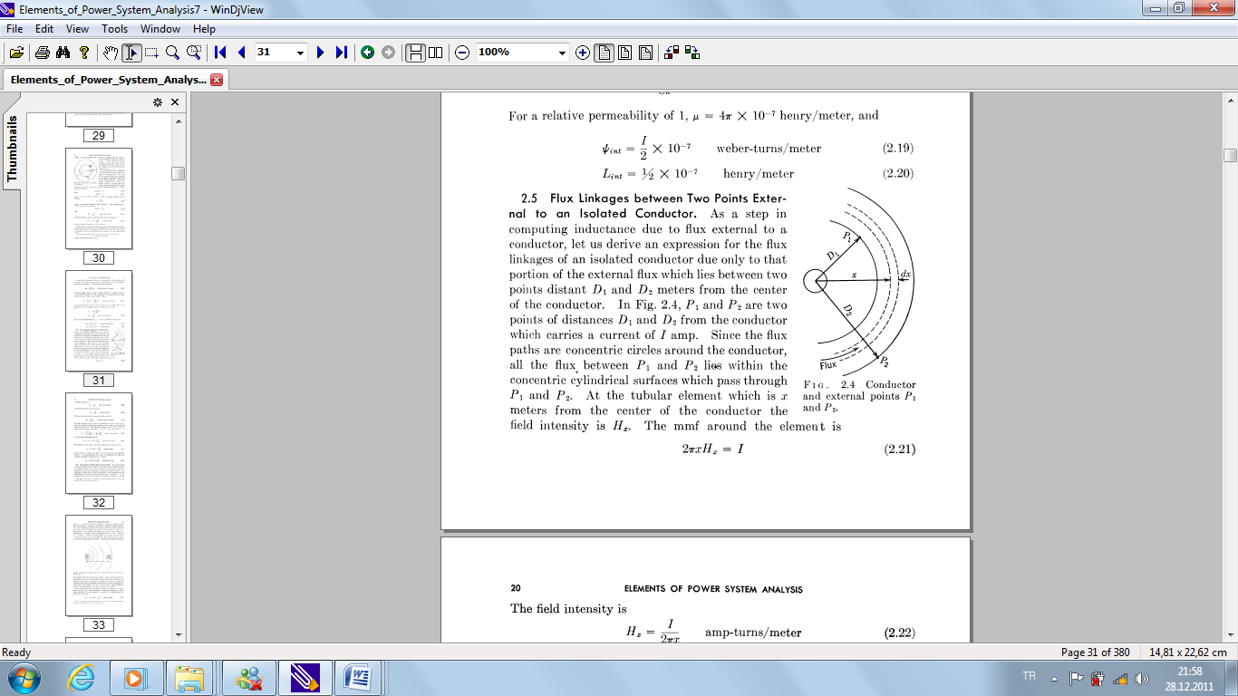




. Flux Linkages Between Two Points External to an Isolated Conductor
The field intensity
Flux density in the element
The flux in the tubular element of thickness dx
Total Flux Linkages between P1 and P2
Conductor and External Points P1 and P2

Slide 16


Inductance between P1 and P2

Slide 17
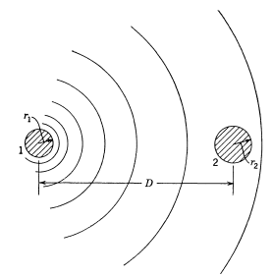


INDUCTANCE 0F A SINGLE PHASE LINE
Consider a Single Phase Line with solid round conductors as shown in the figure.
Assume that D is much greater than r1 and r2.
The external inductance due to current passing through conductor 1
Conductors of different radii and the magnetic field due to current in conductor 1 only.
For internal flux only,
The total inductance due to current in conductor 1

Slide 18




Inductance of a Single Phase Line
Note that
Combining the terms
=

Slide 19



Inductance of a single phase line
Resulting flux for the two conductors is the summation of mmfs of both conductors (conductor 2 is the return)
For conductor 2,
Hence, for the complete circuit
If

Slide 20

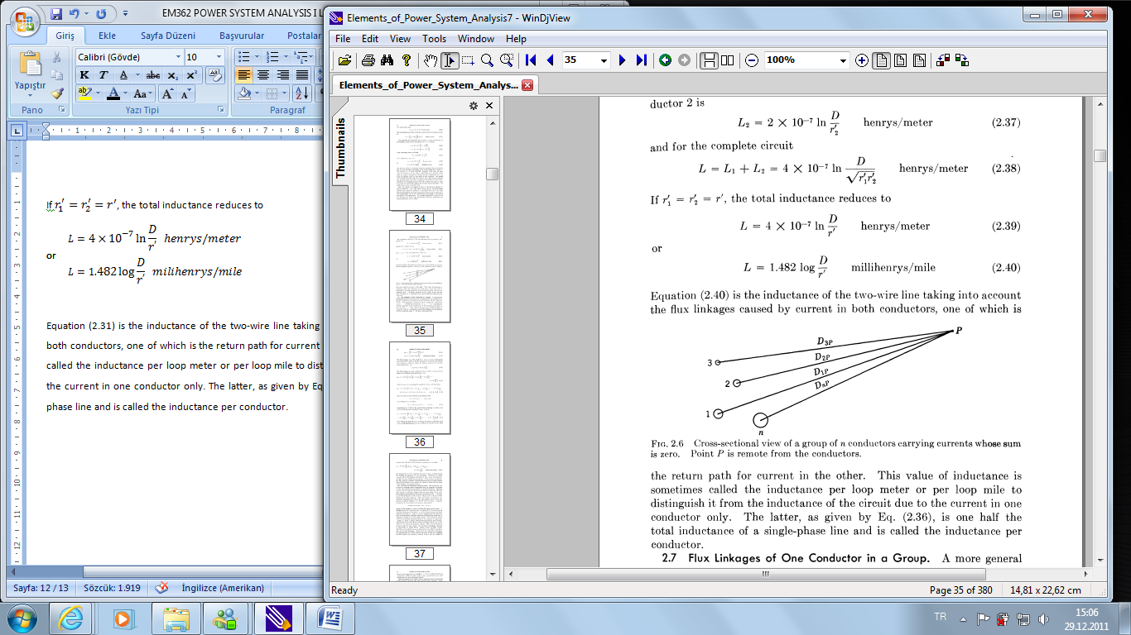




Flux Linkages of One Conductor in a Group
the flux linkages of conductor 1 due to I₁ including internal flux linkages but excluding all the flux beyond the point P.
The flux linkages ψ_{1F} with conductor 1 due to all the conductors in the group is
the flux linkages ψ_{1F2} with conductor 1 due to I₂,
Cross-sectional view of a group of conductors carrying currents whose sum is zero. Point P is remote from the conductors.
Expanding the terms and grouping

Slide 21

Flux Linkages of One Conductor in a Group
Since the sum of all the currents in the group is zero
and, solving for I_{n}, we obtain
and substituting for In
Move P infinitely very far then,

Slide 22
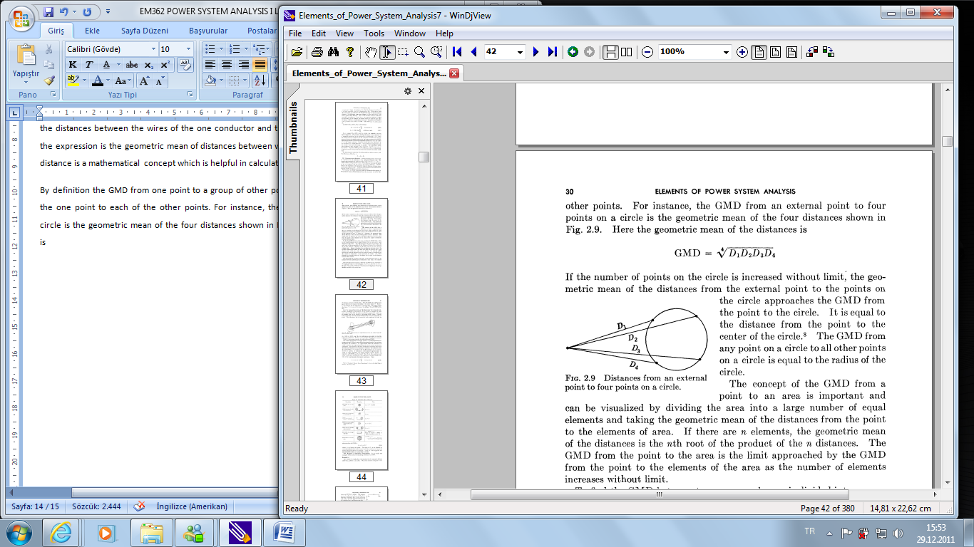
INDUCTANCE CALCULATION AND GEOMETRIC MEAN DISTANCE
1
2
Distances from an external point to four points
P
3
4
By definition the GMD from one point to a group of other points is the geometric mean of the distances from the one point to each of the other points. For instance, the GMD from an external point to four points on a circle is the geometric mean of the four distances shown in Figure. Here the geometric mean of the distances is

Slide 23

Inductance Calculation
Ds is the equivalent self GMD
Dm is the Geometric Mean Distance

Slide 24
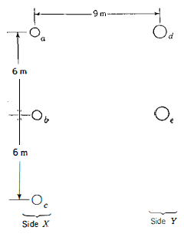
EXAMPLE
One circuit of a single-phase transmission line is composed of three solid wires, each 0.25 cm. in radius. The return circuit is composed of two wires, each 0.5 cm. in radius. The arrangement of conductors is shown in Fig. Find the inductance due to the current in each side of the line and the inductance of the complete line .
Find the GMD between sides X and Y.

Slide 25


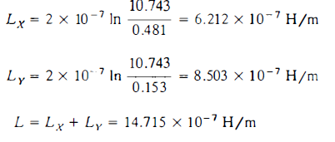



SOLUTION
GMD BETWEEN X AND Y
SELF GMD OF Y
SELF GMD OF SIDE X

